Slide 1
AUTOMATED FACE RECOGNITION ATTENDANCE SYSTEM USING DEEP LEARNING
Team Details
G ROHITH REDDY – 20EG105113
M LIKHITH – 20EG105129
M MANOJ KUMAR – 20EG105131
M KARTHIKEEYA – 20EG105133
M HEMANTH – 20EG105701
Project Supervisor
Dr. G PRABHAKAR RAJU
ASSISTANT PROFESSOR

Slide 2
Introduction
Introducing an era-defining solution to the perennial challenge of student attendance management, our project pioneers an Automated Face Recognition Attendance System using cutting-edge deep learning technology. The traditional methods of attendance tracking, prone to errors, inefficiencies, and time-consuming processes, are now surpassed by a seamless and efficient alternative. Our system utilizes facial recognition, ensuring precise identification and marking attendance with a simple glance, eliminating the need for time-consuming methods like attendance sheets or biometrics .
With a focus on user experience, our GUI application streamlines the attendance process for educational institutions and corporate environments alike. Overcoming issues of lost or stolen attendance sheets, our automated system maintains data integrity. By employing background subtraction in face detection, we enhance accuracy, ensuring reliable attendance records. As we are in a new age of attendance management, our system stands as a testament to technological advancement, promising efficiency, accuracy, and adaptability across diverse sectors.

Slide 3
Problem Statement
Maintenance of student attendance is the most difficult task in various institutions. Every institution has its own method of taking attendance such as using attendance sheet or by using some biometric methods. But these methods consumes a lot of time. Mostly student attendance is taken with the help of attendance sheet given to the faculty members. This consumes a lot of work and time. We do not know whether the authenticated student is responding or not. Calculation of consolidated attendance is another major task which may cause manual errors. In some other cases the attendance sheet may become lost or stolen by some of the students. To overcome such troubles we are in need of automated attendance management system.

Slide 4
Problem Illustration
In the evolving landscape of education and workforce management, the demand for precise attendance tracking systems is critical. This project introduces an innovative solution—an Automated Face Recognition Attendance System powered by deep learning. Traditional attendance methods often fall short due to inaccuracies, manual efforts, and time-consuming processes. To overcome these challenges, our project leverages advanced deep learning techniques to establish a robust, real-time, and automated attendance tracking system. So, to solve this issue, we have used the technology which enables precise identification through facial recognition, allowing attendance to be effortlessly marked with a simple glance. The system excels in accurately recognizing individuals, even under varying lighting conditions and angles. Emphasizing user experience, our project incorporates an intuitive and user-friendly interface through a GUI application is developed. This ensures seamless integration with educational institutions and corporate environments. Users can easily initiate attendance marking, monitor real-time data, and access historical attendance records. The advantages of our system extend to diverse domains such as event management, security, and access control, where accurate attendance tracking is paramount. As we look ahead, the Automated Face Recognition Attendance System signifies a technological leap, eliminating the complexities associated with traditional attendance management methods. With its precision, efficiency, and adaptability, this system is poised to revolutionize attendance tracking across various industries.

Slide 5
Proposed Method
These disadvantages are overcome with the help of automated attendance management which does not consume time and the data is not lost until we erase it. This method is most efficient in these days. In face detection the face of images are marked with the help of rectangle. The face detected after background subtraction is accurate as compared to the face detected from an image which is not background subtracted. The detected face is then cropped. Finally all the face of individuals are detected and cropped from the image. Each cropped image is taken for the comparison of images in database and finally the attendance is marked.

Slide 6
Proposed Method Illustration
The project is developed using the Python Programming language and the deep learning algorithm called CNN algorithm. We also use OpenCV which is used for capturing of the images using webcam. Mainly we use two algorithms for the development of the project those are CNN algorithm of Deep learning and KNN algorithm. Using the CNN algorithm, we are going to extract the image features of a person and by using the KNN algorithm we are going to check the image of a person with the image which is present in the backend or the image which is given at the time of registration of the student. The project is initially designed based on the two users those are admin and faculty. The admin is going to add the student and view the student. He can also view the attendance report of the students. The faculty user has an option of registration of the faculty. He is going to register initially and then he is going to login into the application. After login of the faculty, we have provided two options those are, Take attendance and reports. By clicking on the take attendance, the camera is going to open and take the snapshot of the students. By clicking on the view reports we can see the list of students who are present and absent in the form of table. The faculty can also download the attendance in the form of excel for the easy access.

Slide 7
Experiment Environment
Pycharm IDE/ VS Code:
PyCharm/VS Code is a powerful integrated development environment (IDE) for Python, offering features like intelligent code completion, debugging, and project navigation. Its user-friendly interface and robust tools make it a preferred choice for developers working on Python projects.
MYSQL Database:
MySQL is an open-source relational database management system (RDBMS) that stores and organizes data. It uses a structured query language (SQL) for managing and manipulating databases, making it widely used for web applications and various software systems.
Python Language:
Python is a high-level, interpreted programming language known for its simplicity and readability. It supports multiple paradigms, including procedural, object-oriented, and functional programming. Python is widely used in web development, data science, artificial intelligence, and automation, making it a versatile and popular choice for programmers.
Along with these we will be using the libraries like OpenCV and algorithms like CNN algorithm, KNN algorithm.
We will be also using the webcam which is used for capturing the images of the student.

Slide 8
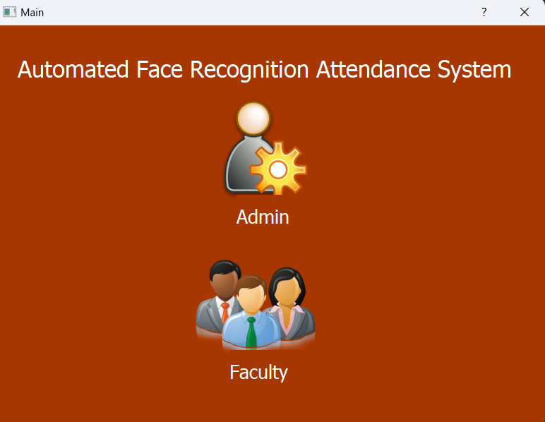
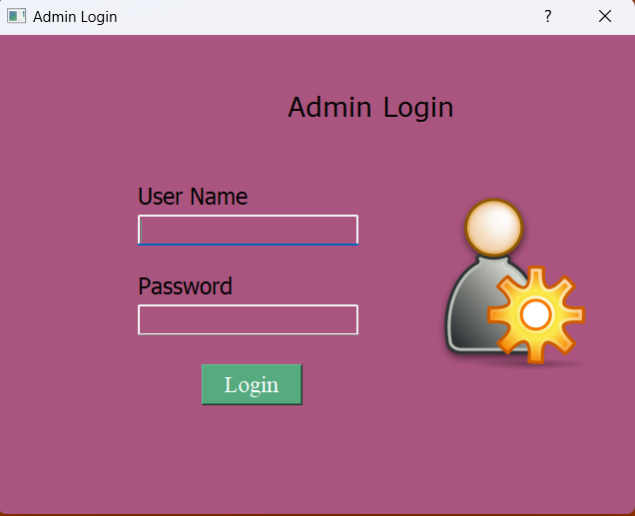
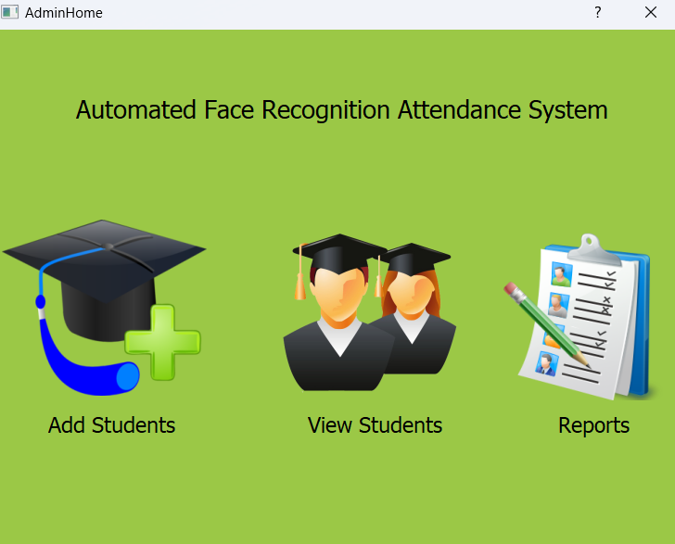
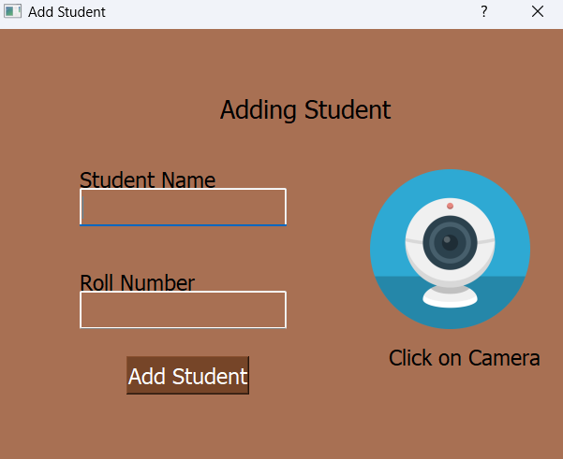
Experiment Screen shorts

Slide 9
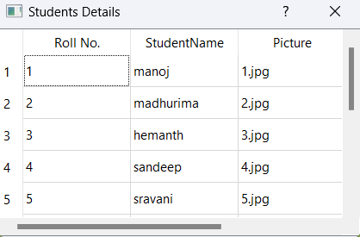
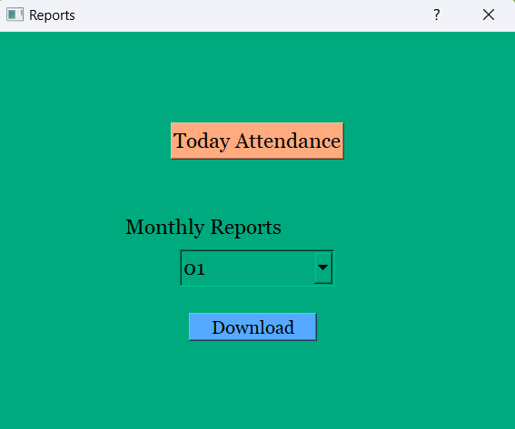
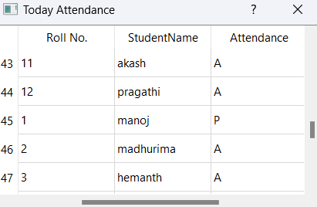
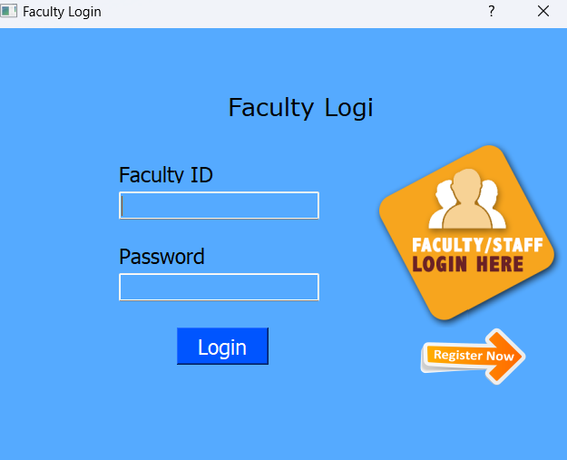
Experiment Screen shorts

Slide 10

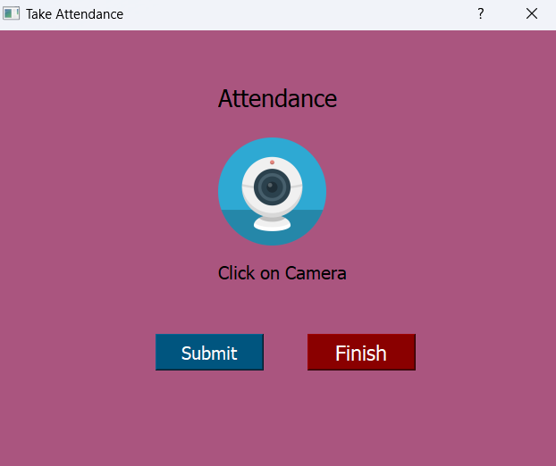
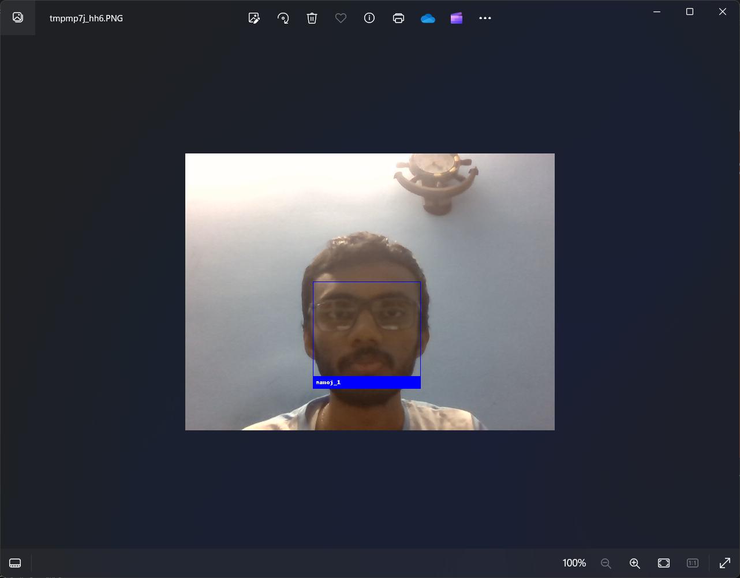

Experiment Screen shorts

Slide 11
Experiment Results
The experimental results of the attendance management system showcased its efficacy in accurately recognizing faces and tracking attendance. Leveraging the Python language, along with specialized libraries and algorithms, such as face_recognition for facial recognition and dlib for face detection, the system demonstrated robust performance. The integration of K-Nearest Neighbors (KNN) algorithm for face recognition, coupled with OpenCV for image capturing and processing, ensured reliable attendance tracking. The graphical user interface developed using PyQt5 facilitated seamless interaction and intuitive operation. Moreover, the utilization of openpyxl and MySQL. Connector libraries enabled efficient data management and storage. The experimental outcomes underscored the system's ability to automate attendance tracking processes effectively, offering a practical solution for educational institutions and organizations.
The final outcome of the project is of downloading the attendance data month wise and also able to see the today’s attendance by using the CNN algorithm with face_recognition and dlib libraries for face detection and KNN algorithm for face recognition.

Slide 12
Experiment Results

Slide 13
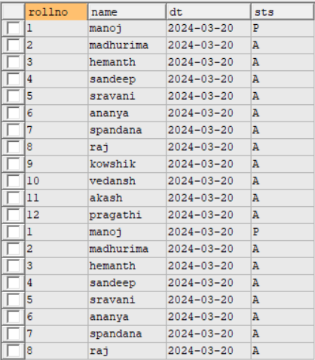
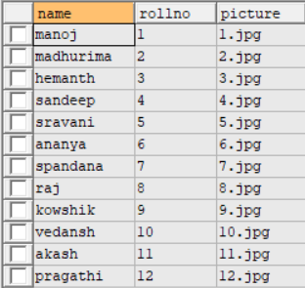
Experiment Results
The following are the images of the database and the tables used in this project:

Slide 14
Findings
The development and implementation of the attendance management system exemplify the potential of leveraging Python-based tools and algorithms for efficient and accurate attendance tracking. Through the utilization of face_recognition and dlib libraries for deep learning-based face detection and recognition, coupled with the KNN algorithm, the system demonstrated robust performance in identifying individuals and recording attendance. The integration of OpenCV for image capturing, along with PyQt5 for the graphical user interface, ensured a user-friendly experience. Additionally, the system's ability to store data in Excel files and MySQL databases facilitated seamless data management. Overall, the attendance management system represents a reliable and effective solution for automating attendance tracking processes in educational institutions and organizations, offering convenience, accuracy, and efficiency.

Slide 15
Justification
KNN for classification of data based on similarity measure. K in KNN is a parameter that refers to the number of the nearest neighbours to including majority voting process.
d=√((x2-x1)² + (y2-y1)²) to find the distance between any two points.
CNNs are a class of deep learning algorithms designed for image recognition. They use convolutional layers to extract hierarchical features from input images. CNNs leverage filters to detect patterns, enabling them to learn and recognize complex visual representations in a hierarchical manner.
Size of Feature Map (convolution layer)= (size of input map – size of kernel) + 1
Size of Feature Map if Stride is present(convolution layer) = ((size of input map – size of kernel)/stride) + 1
Size of Feature Map if Stride and Padding is present (Relu Layer ) =
((size of input Map – size of kernel + 2*padding)/stride) + 1
We will be also using the max pooling and average pooling (if required) to reduce the dimension of the input by keeping the same information present in output. ( Pooling Layer )
Later we will convert the 2 dimensional arrays into 1 dimensional linear vector by using flattening. (fully connected layer

